Slide 1

Chapter Two HTML
Web design and development
Notes:
NOTE:
To change the image on this slide, select the picture and delete it. Then click the Pictures icon in the placeholder to insert your own image.

Slide 2
What is HTML?
HTML is a language for describing web pages.
HTML is the lingua franca of the web, that is it the language that makes it possible for various computers to communicate with each other.
HTML stands for Hyper Text Markup Language
Hypertext: refers to the ability to create links to other pages and other web resources. (Hyperlinks: makes the web go around)
Markup: means it is used for creating pages of formatted text along with images and other resources embedded in the page.
Notes:
A markup language is a system for annotating a document in a way that is syntactically distinguishable from the text.

Slide 3
What is HTML?
HTML is a markup language, not a programming language.
A markup language is a set of markup tags.
The tags describe document content
In other words, the markup tags provide information about the page content structure.
HTML documents contain HTML tags and plain text.
HTML documents are also called web pages.
Originally based on SGML (Standard Generalized Markup Language).
Notes:
A markup language is a system for annotating a document in a way that is syntactically distinguishable from the text.

Slide 4
What is HTML?...
It is a language used to create documents for the World Wide Web.
HTML is not case sensitive language.
HTML documents can include graphics, and more importantly links to other documents – hypertext.
An HTML document can be produced in free-format, i.e. it doesn’t matter what the text file looks like it is the browser that does the formatting. HTML is not so much concerned about the appearance of the documents but about the structure of a document.

Slide 5
History of HTML
1991
HTML first published
1995
HTML 2.0
After HTML 4.01 was released, focus shifted to XHTML and its stricter standards.
1997
HTML 3.2
1999
HTML 4.01
XHTML 2.0 had even stricter standards than 1.0, rejecting web pages that did not comply. It fell out of favor gradually and was abandoned completely in 2009.
2000
XHTML 1.0
2002 -2009
HTML5 is much more tolerant and can handle markup from all the prior versions.
XHTML 2.0
HTML5
Though HTML5 was published officially in 2012, it has been in development since 2004.
2012

Slide 6
The Birth of XHTML
The success of XML rather left HTML in the lurch because HTML documents are not valid XML documents that the new XML processor cannot read them.
On the other hand HTML browsers cannot read XML documents.
An XHTML is an XML-based language that reproduces the functionality and structural rules of HTML, but subject to the rules of XML, and uses the same mark-up elements names. The main differences are:
All elements and attribute names must be in lowercase.
All empty elements must be written using XML’s special empty-element tag
All end tags must be present and there are no optional end tags
The HTML elements must contain a single head element, followed by a single body element or single frameset element.
Every head must contain a single title.

Slide 7
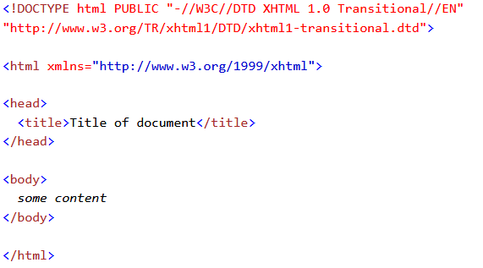
XHTML Structure

Slide 8
XHTML vs. HTML
HTML is forgiving of sloppiness
XHTML requires strict usage
Stricter usage = better interoperability = websites work better on more devices.

Slide 9
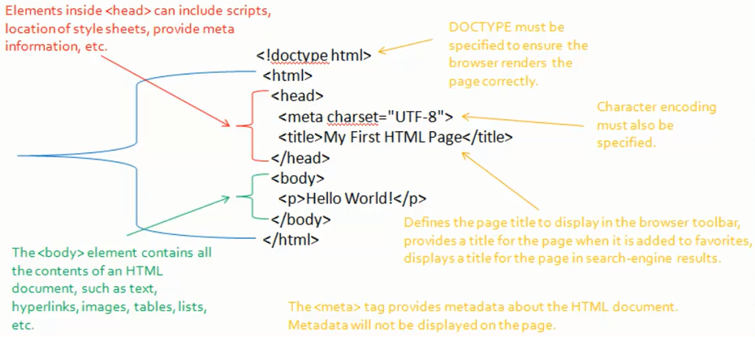
HTML Page Structure

Slide 10
DOCTYPE Declaration
Tell the browser what version of HTML to be expected in the document.
<!DOCTYPE html>
Should be the very first thing in your document
Before any comment or even a whitespace.

Slide 11
Structure of an HTML Document
Every HTML document should start by declaring that it is an HTML document.
Document Object Model tree is formed by using <html>.
These tags are of the form:
<html>
Should appear at the beginning of your document
</html>
Should appear at the end of your document

Slide 12
Head of an HTML Document
The HEAD section of an HTML document is like the front matter of the book. It where the information about the document goes. The meta information that describes things about the document that support how it is rendered, how it is navigated, how it is assembled and otherwise how the document works.
The HEAD of an HTML document is where information such as the document’s title, can be placed.
The region associated with the head of a document should be declared using the following HTML tags:
<head>
Should appear after the <html> definition.
</head>
Should appear after any header text

Slide 13
Head of an HTML Document
A typical entry in the HEAD of a document would be:
<title>
Title of the document
</title>

Slide 14
Head of an HTML Document
Meta tag: Used to describe various aspects of your page.
Search engine optimization – Now search engines are not using them
Meta tag: data about data
<meta charset=“UTF-8” /> - character set of the document
<meta http-equiv=“refresh” content=“3; url=http://livescore.com/” />
<meta http-equiv=“content-type” content=“text/html; charset=UTF-8” />
<meta name=“keywords” content=“Amazing,New,Bill,Page,blah blah” />

Slide 15
Quiz 1 ..Using Meta tag
Create HTML 5 document by the name Quiz.html with the following meta tags?
Description
Keywords
Robots
Redirect meta tag which redirects to another html document after 5 second.
Create a cookie using meta tag by the name “quiz cookie”
Add a base name to your document
And also create an icon
Hint
<meta name=“” content=“” />
<base href=“” />
<link rel=“icon” href=“” />

Slide 16
Body of an HTML Document
The BODY of an HTML document is where all the information you wish to view must appear.
The region associated with the BODY of a document should be declared using the following HTML tags:
<body>
Should appear after the </head> definition
</body>
Should appear after the document’s text but before the </html> tag
An HTML document can be freely formatted as you wish.

Slide 17
Web Browsers
The purpose of a web browser (such as Google Chrome, Internet Explorer, Firefox, Safari) is to read HTML documents and display them as web pages.
The browser does not display the HTML tags, but uses the tags to determine how the content of the HTML page is to be presented / displayed to the user.
In other words, the purpose of a web browser (like Internet Explorer or Firefox) is to read html documents and display them as web pages.

Slide 18
Creating HTML Pages
An HTML file must have an .htm or .html file extension.
HTML files can be created with text editors:
NotePad, Note Pad ++, Visual Studio Code
Or HTML editors
Microsoft FrontPage
Macromedia Dreamweaver
Netscape Composer
Expression Web
Visual Studio

Slide 19
HTML Tags
HTML markup tags are usually called HTML tags.
HTML tags are keywords (tag names) surrounded by angle brackets like <html>
HTML tags normally come in pairs like <b> and </b>
The first tag in a pair is the start tag, the second tag is the end tag
The end tag is written like the start tag, with a forward slash before the tag name
Start and end tags are also called opening tags and closing tags
<tagname>content</tagname>
Follows the <tag_on> </tag_off> format

Slide 20
HTML Tags…
HTML tags should always be nested and never over-lapping
Most HTML tags are like brackets – they form pairs; and various pairs must always match.
For example, the brackets:
[(< and >)] match;
whereas the grouping:
[(< and )]> form a mis-match!

Slide 21
HTML Elements
“HTML tags” and “HTML elements” are often used to describe the same thing.
But strictly speaking, an HTML element is everything between the start tag and the end tag, including the tags:
HTML Element:
<p>This is a paragraph.</p>

Slide 22
Types of HTML Elements
There are two different types of tags:
Container Element: Container Tags contains start tag & end tag
i.e. <html>…</html>
Empty Element: Empty Tags contains start tag
i.e. <br>
Better written with / as <br />

Slide 23
HTML Attributes
HTML elements can have attributes
Attributes provide additional information about an element
Attributes are always specified in the start tag
Attributes come in name/value pairs like: name=“value”
The quotes for value in attributes are optional, in XHTML it is required.
Can use either a single quote or a double quote.

Slide 24
Content Models in HTML5 A description of the element's expected contents
Previous version of HTML
Block and Inline
A content model defines what types of content are excepted in certain context. A given element may only have content that matches the requirements of its content model.
A description of the element's expected contents.
An element’s content model may include zero or more categories of content and an element may also belong to zero or more categories.

Slide 25
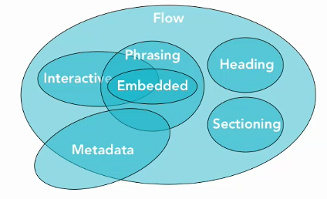
Content Models in HTML5 A description of the element's expected contents
In HTML5 there are seven content models. These content models overlap each other that is some elements may belong to more than one content model.

Slide 26
Content Models in HTML5 A description of the element's expected contents
Flow: Most elements that are used in a body of an HTML document are flow content. These includes text, paragraphs, headings, lists, hyperlinks images, embedded media… just about everything.
Phrasing: includes the text of the document as well as elements that markup the text. These includes images, hyperlinks, form elements, text markup like <b> and <i> elements and pretty much anything else you can put in a paragraph.
Heading: includes <h1> through <h6> heading elements and the new <hgroup> element.
Sectioning: includes the new sectioning elements <article> <aside> <nav> <section>

Slide 27
Content Models in HTML5 A description of the element's expected contents
Embedded: is a content that imports another resources into the document or content that is otherwise inserted into the document. Includes video, audio, flash other plugins as well as images, canvas and even math object.
Interactive: is a content that is specifically intended for user interaction. Like hyperlinks, form elements, menus and even media if it has the controls attribute.
Metadata: is a content that sets up the presentation or behavior of the rest of the content or that sets up the relationship of the document with other documents or conveys other out of bound information.
Read More:- https://www.w3.org/TR/2011/WD-html5-20110525/content-models.html

Slide 28
Quiz 2
Classify the following elements based on the 7 content models ?
<a>
<p>
<audio>
<b><i>
<article>

Slide 29
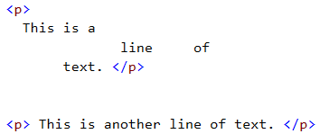
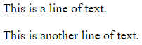
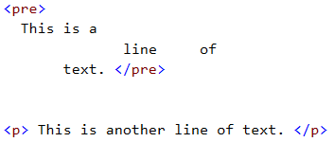
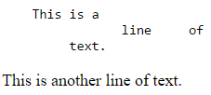
Whitespace in HTML
By using the special element pre, we can display whitespaces.

Slide 30
Comments in HTML
Comments can exists anywhere between the
<html></html> tags
Comments start with <!-– and end with -->
<!– Company Logo (a JPG file) -->
<img src="logo.jpg" alt=“Company Logo">
<!–- Hyperlink to the web site -->
<a href="http://Microsoft.com/">Microsoft</a>
<!–- Show the news table -->
<table class="newstable">
...

Slide 31
Display Modes > Block and Inline Elements (tags)
Block elements:
Elements that contain other elements.
Add a line break before and after them, and expand to 100% width.
Eg. <div>, <p>, <h1>, <ul> are block elements
<p> tag is the only block level element that cannot contain other block level elements. Can only contain text and inline level elements.
Inline elements:
Typically represent the current inline of text.
Don’t break the text before and after them, they flow with it.
Eg. <span>, <a>, <em>, <img> are inline elements

Slide 32
Block and Inline Elements
Can change inline elements to block using stylesheet.
style=“display: block”
Block elements can also be changed to inline elements.
style=“display: inline”

Slide 33
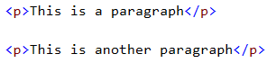
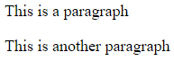
HTML Paragraphs
HTML will treat all text as one paragraph unless paragraph markers are added around each physical paragraph.
HTML documents are divided into paragraphs.
HTML paragraphs are defined with the <p> tag.
One can also write texts outside of a paragraph but it is always recommended to write a text inside a paragraph or another block element.

Slide 34
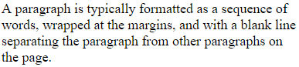
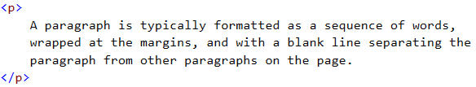
HTML Paragraphs… > Alignment
Paragraphs by default are aligned to the left.
You may use the align attribute to align paragraphs but it is not recommended and it is actually obsolete on the latest version of HTML.

Slide 35
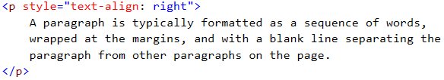
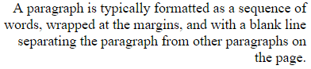
HTML Paragraphs
A better way to do this is using CSS.

Slide 36
Character References
Character | Named | Decimal | Hexadecimal
< | &lt; | &#60; | &#x3c;
> | &gt; | &#62; | &#x3e;
& | &amp; | &#38; | &#x26;
“ | &quot; | &#34; | &#x22;
‘ | &apos; | &#39; | &#x27;
http://developers.whatwg.org/named-character-references.html

Slide 37
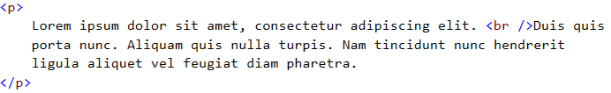
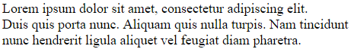
Line Break Tag
If you want a line break or a new line without starting a new paragraph, use the <br />tag.

Slide 38
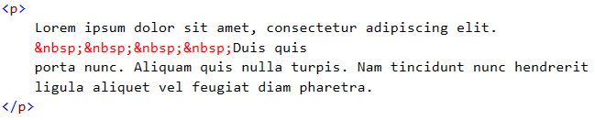
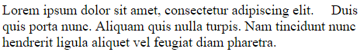
Line Break and Spaces > Prevent default line break / wrap
The browser also controls the spacing between words. &nbsp; (special character) – non-braking space

Slide 39
Phrase markup elements
They are designed to markup parts of text according to their usage.
Let non visual browsers to know what to do with your text.
All phrase markup elements are inline markup elements.
<em>: Defines emphasized text
<strong>: Defines important text
<q>: Defines a quoted text (is not supported on all browsers)
<code>: Defines monospace text
<abbr>: Defines abbreviation
<acronym>: Defines acronym (meaning)
<dfn>: Defines instance (define a word when you use it for the first time)

Slide 40
Phrase markup elements
<kdb>: Defines a keyboard element
<sample>: Defines a sample text
<var>: Defines variable
<sub>: Defines a subscript
<sup>: Defines a superscript

Slide 41
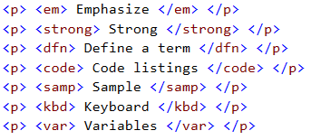
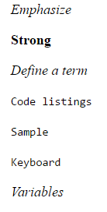
Phrase markup Elements > Example

Slide 42
Font markup elements
Different from phrase markup elements.
Defines the visual style that the elements are going to be rendered on a visual browser on the screen.
The phrase markup elements are for giving meaning to the text.
In reality, if you care about how your text is going to be rendered on the screen you want to use the font level markups not the phrase level markups.
Phrase level markups don’t guarantee how the phrase is going to be rendered on the screen.

Slide 43
Font markup elements
Inline markup elements and they are container elements.
<b>: Defines bold text
<i>: Defines a part of text in an alternate voice or mood, italic
<big>: Defines big text
<s> or <strike>: Defines strike text (Strikethrough)
<small>: Defines smaller text
<tt>: Defines teletype text (renders it in monospace font)
<u>: Defines underline text

Slide 44
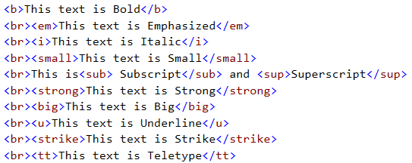
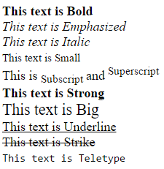
Phrase & Font markup elements > Example

Slide 45
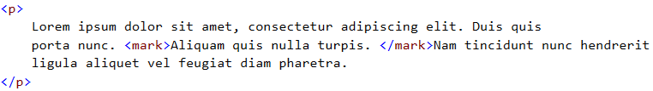
Mark Tag
HTML provides a new inline element called mark for highlighting text. (<mark>….</mark>)
Can be styled with stylesheet.

Slide 46
HTML Headings
Headings in HTML add structure to your document.
Valuable for search engines and other automated tools that might want to categorize your documents and to understand the structure of them a little bit so that they can give you intelligent results.
A heading level is declared by using the following tags:
<hnumber>
Should appear at the beginning of your heading.
</hnumber>
Should appear at the end of your heading.

Slide 47
HTML Headings
HTML headings are defined by the <h1> to <h6> tags. (Six heading elements)
All the six heading elements are container tag and requires a closing tag.
<h1> will print the largest heading.
<h6> will print the smallest heading.
It is a block level element and other block elements can be nested within a heading tag.
Example:
<h3> Heading 3
<p> paragraph in heading </p>
</h3>

Slide 48
HTML Headings…
Example
<h1>This is a heading</h1>
<h2>This is a heading</h2>
<h3>This is a heading</h3>
It is very important that you balance your text to the various heading styles. In most cases heading level 1 should be used for top level or main headings and heading level 2 and 3 for “side” headings.
Note: Heading level 4 is the same size as the default font and higher levels of heading begin to get smaller in comparison to the body text.

Slide 49
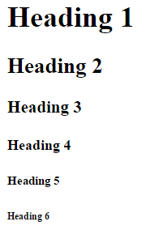
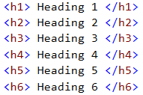
HTML Headings…

Slide 50
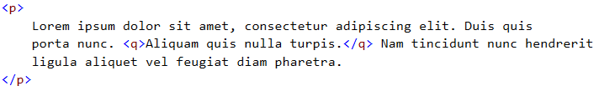
Quotes
Quotation marks can of course be added using keyboards. But smarter quotes can be added using the <q> element.
<q>: might not be supported by all browsers but it adds a double quote around some text.
It also uses the smart rule if it is nested.
Different for different browsers unless a stylesheet is written.

Slide 51
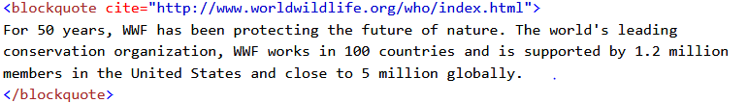
Quotes
Block Quote: It is a block level quote.
<blockquote>: doesn’t put a quote around a text, but adds some indenting.

Slide 52
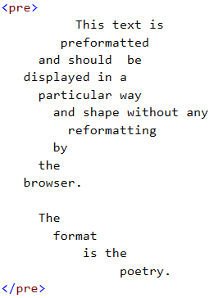
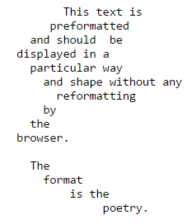
Preformatted Text
Sometime you might want to format your text the way you see it on your text editor.
The <pre> tag allows you to achieve that.
It is a block level tag.
Text is mono spaced.
Inline formatting is supported inside it.
Used to display a code (programming code) or some poetry on a webpage.

Slide 53
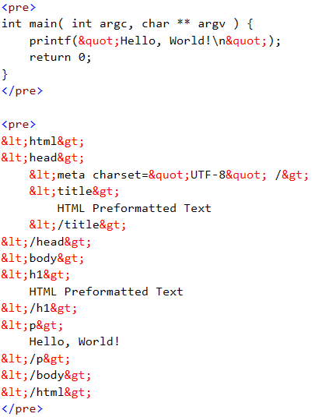
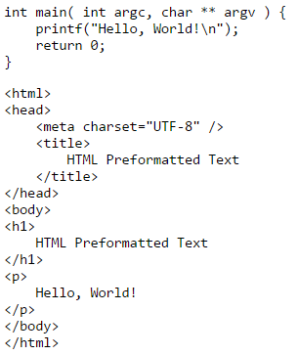
Preformatted Text

Slide 54
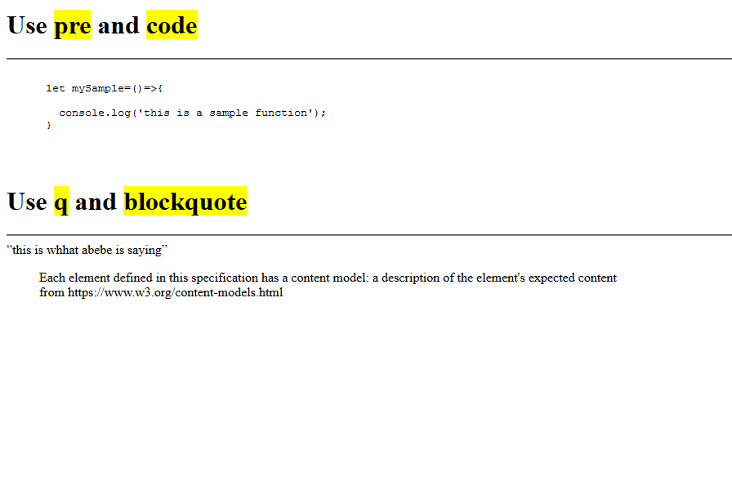
Quiz 3 ..Create the following page quiz3.html

Slide 55
HTML List
Lists provide methods to show item or element sequences in document content. There are three main types of list:
Unordered Lists: unordered list are bulleted
Order lists: Ordered lists are numbered
Definition lists: used to create a definition list

Slide 56
Unordered List
An unordered list is a list of items. The list items are marked with bullets (typically small black circles).
It is a block level element
An unordered list starts with the <ul> tag. Each list item starts with the <li> tag.
Different kinds of bullets:
disc (default)
circle
square
<ul Type=“disc”>…</ul> (obsolete)
Can nest one unordered list inside another unordered list
Unordered List :
ThinkPositve
Never Depressed
Keep Smiling

Slide 57
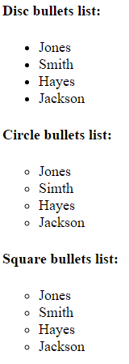
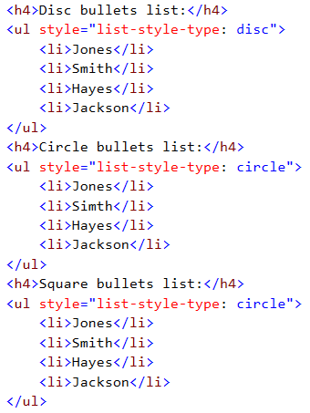
Unordered List… > Example

Slide 58
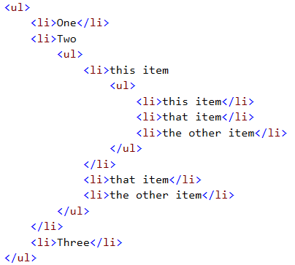
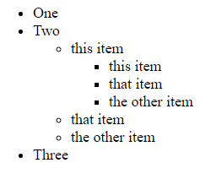
Unordered List… > Example

Slide 59
Ordered List
An ordered list is also a list of items. The list items are marked with numbers.
It is a block level tag.
An ordered list starts with the <ol> tag. Each list item starts with the <li> tag.
The TYPE attribute has the following possible values, but not limited to:
type = “1” (Arabic numbers) or type=“number”
type = “a” (Lowercase alphanumeric) or type=“lower-alpha”
type = “A” (Uppercase alphanumeric) or type=“upper-alpha”
type = “i” (Lowercase Roman numbers) or type=“lower-roman”
type = “I” (Uppercase Roman numbers) – or type=“upper-roman”
By default Arabic numbers are used.
You can nest an ordered list inside another ordered list.

Slide 60
Ordered List…
The start attribute for ordered list allows you in specifying from what number your list should start.

Slide 61
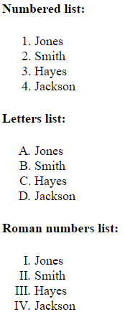
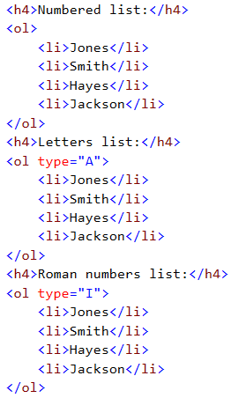
Ordered List > Example

Slide 62
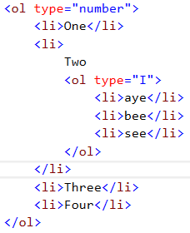
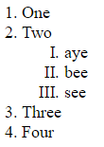
Ordered List… > Example

Slide 63
Definition List / Description List
A definition list is not a list of single items. It is a list of items (terms), with a description of each item (term).
A definition list starts with a <dl> tag (definition list).
Each term starts with a <dt> tag (definition term).
Each description starts with a <dd> tag (definition description).
Definition is indented.
Renders without bullets.
Definition List :
Success
Fail First,
Happy
Smile Always

Slide 64
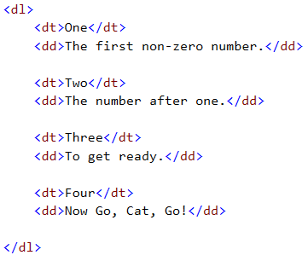
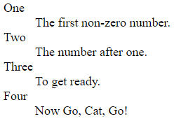
Definition List > Example

Slide 65
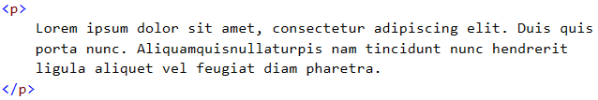
Suggesting word-break opportunities
HTML provides two techniques for breaking words.
The soft hyphen (&shy;)
The <wbr> tag

Slide 66
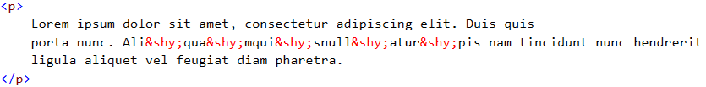
Suggesting word-break opportunities
Soft hyphen (named entity: &shy;)
Alternatively one can use <wbr/> inplace of the soft hyphen (&shy;).
<wbr /> does the same wrapping, but it does it without a hyphen.
Either of these tags, disrupt text to speech applications.

Slide 67
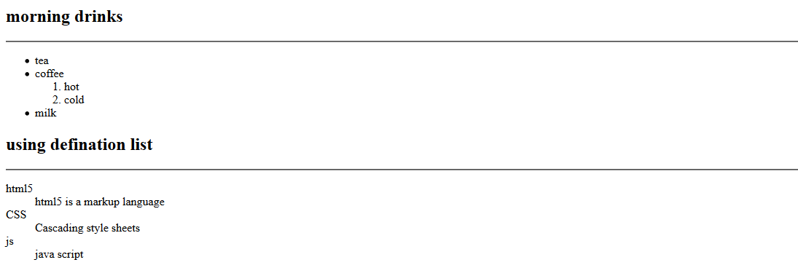
Quiz5.html

Slide 68
HTML Images
Images are a major part of most website design.
While the web is not exclusively a visual medium it is primarily so and images are a valuable parts of that equation.
HTML Image is an inline tag.
HTML images are defined with the <img> tag.
To display an image on a page, you need to use the src attribute.
Src stands for “source”. The value of the src attribute is the URL of the image you want to display on your page.

Slide 69
HTML Images…
Common image formats:
JPEG which is used for photographs
GIF which is used for solid color images such as icons and logos
PNG which provides versatility but may not be supported by older browsers.
It is an empty tag.
<img src=“url” />
Example:
<img src=“w3schools.jpg” />
<img src=“w3schools.jpg” width=“104” height=“142” />

Slide 70
HTML Images… > Image Attributes
src Defines an image on a page, src stands for source (can be relative or absolute)
alt Define “alternate text” for an image
Required in the specification
Provides text that will be displayed on the event the browser can’t display the image, or if the browser is able to load the image but it takes a while to get around to it.
For non visual browsers.
title Defines the text displayed when you hover the mouse over the image, a tooltip
width Defines the width of the image (not required but important)
height Defines the height of the image (not required but important)
Notes:
Importance of having a width and a height attribute, letting know the browser how much space is required for the image before the browser even loads (get) the image.
- Graceful loading

Slide 71
HTML Images… > Image Attributes
align Specifies the alignment of an image according to surrounding element. Make an image float (possible values: left, right, middle, top, bottom) – bottom is the default. Obsolete in HTML 5
background Add a background image to an HTML page (not an image attribute)

Slide 72
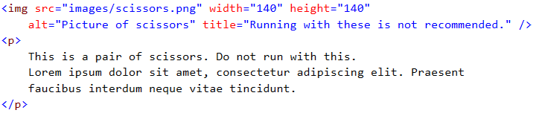
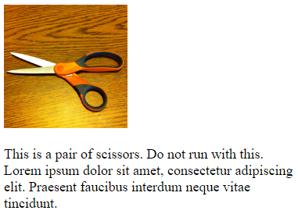
HTML Images… > Example (Floating/Aligning)
Target: Display the picture on the left side and the text on the right side.

Slide 73
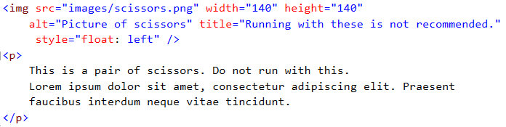
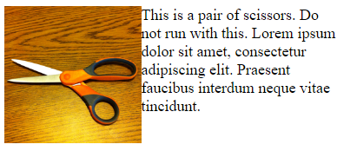
HTML Images… > Example (Floating/Aligning)
Use the float property in the CSS.

Slide 74
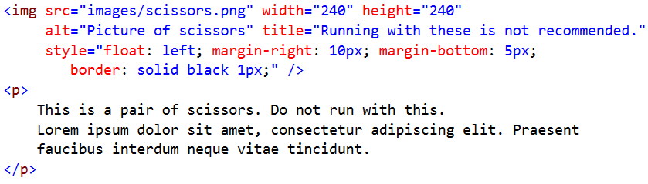
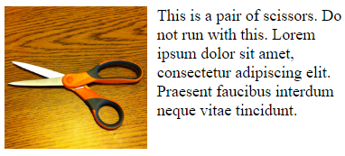
HTML Images… > Example (Floating/Aligning)
The margin property in CSS allows you to create some space between your image and the paragraph.

Slide 75


HTML Images… > Break Text
When text is flowing around an image, sometimes you will need to force some text to start after the image.
<br clear=“right” /> obsolete in HTML5
In HTML5: clear property in CSS.
clear: left, right, both

Slide 76

HTML Images… > Break Text…

Slide 77

HTML Images… > Break Text…

Slide 78

Quiz6.html

Slide 79
Image Map
HTML provides a feature to define regions of an image as links to different URLs, this is called Image Map.
This can be achieved by the usemap attribute of an image tag in HTML together with HTML map tag (<map>…</map>.
Example: usemap=“#scissorsmap”
Notice that the value of the usemap is preceded by a # sign. (Fragment Address)
The map tag has a name (specified by the name attribute) that should match the name specified in the usemap attribute of the image.
The map tag has area elements inside of it, to define areas in the image.

Slide 80
Image Map… > area element attributes
shape: rect, circle or poly
coords: coordinates
rect: define two points (the upper left and lower right points in x,y format)
Example: 0, 0, 50, 50
circle: define the coordinates of the center of the circle (x, y format) and radius of the circle (r).
Example: 150, 25, 25
poly: define sequence of coordinates (x,y format)

Slide 81
Image Map… > area element attributes
alt: used when the browser not rendering the map properly
title: displayed when you hover over the map, or used in a descriptive context
href: is a link to a resource

Slide 82


Image Map > Example

Slide 83
HTML Links/ Hyperlinks/ Hypertext links
Imagine a book.
Go to table of content.
Turn the page until we find the page
A hyperlink is a reference (an address) to a resource on the web.
Hyperlinks can point to any resource on the web: an HTML page, an image, a sound file, a movie, etc.
The HTML anchor element <a>, is used to define hyperlinks on a document.
Example:
<a href=“http://www.w3schools.com”>This is a link</a>
Note: The link (URL) is specified in the href attribute.

Slide 84
HTML Links/ Hyperlinks/ Hypertext links > Link Colors
By default, links will appear as follows in all browsers:
An unvisited link is underlined and blue
A visited link is underlined and purple
An active link is underlined and red

Slide 85
HTML Links/ Hyperlinks/ Hypertext links > The target Attribute
The target attribute specifies where to open the linked document.
The example below will open the linked document in a new browser window or a new tab
Example:
<a href=“http://www.w3schools.com/” target=“_blank”>Visit W3Schools!</a>
target possible values:
_blank - Opens the linked document in a new window or tab
_self - Opens the linked document in the same window/tab as it was clicked (this is default)

Slide 86
URL
Stands for Uniform Resource Locator
Way of specifying the location of resource on the internet
Resources can be
Webpage
Image
File
Any kind of service…

Slide 87
HTML Links/ Hyperlinks/ Hypertext links > URLs
URL: stands for Uniform Resource Locator
It is a way of specifying a location of a resource on the internet.
A resource can be a webpage, an image, a file of some kind, or really any kind of service. It doesn’t even always map to a particular object on a particular server, It is really just an address.
Protocol / Scheme
Port
FileName
Fragment Identifier
http://www.HiLCoE.net:80/webdevanddesign/index.htm?query#location
Query String
Host / Domain name
Path

Slide 88
HTML Links/ Hyperlinks/ Hypertext links > URLs: Example
http://www.google.com/
Specifies a hostname (www.google.com) and a path (/)
http://www.google.com/contact/
Specifies a hostname and a path (/contact/)
Refers to the default resource on the directory
/contact/ is called a relative URL, and specifies the contact directory on the current host.
If you put a relative URL (/contact/) on a link on a document the browser will complete it to include the host name of the host for the current document.
Another relative url: filename.html
The web browser will complete it with the host name and directory of the current document.

Slide 89



HTML Links/ Hyperlinks/ Hypertext links > Relative URL
Relative URLs are URLs that don’t specify a complete hosting path.
The browser, when it finds a relative URL, it will construct a complete URL and it will use it as the absolute URL of the resource.

Slide 90

HTML Links/ Hyperlinks/ Hypertext links > Fragments (Linking within a page)
In HTML it is possible to link to a part of a page causing the browser to scroll to that point. This is achieved through fragments.
Fragments are used for linking to a section of a page.
They are useful when we have a large page.
How do you achieve that (fragments.html)
Create a link to the section you want to be taken to:
#AFG is a relative URL. (Example: http://localhost:53331/fragments.html#AFG)

Slide 91
HTML Links/ Hyperlinks/ Hypertext links > Image Links
Using images as link is a very common thing.
This is achieved through adding an <img> tag inside an <a> tag.
<a href="default.asp"> <img src="smiley.gif" alt="HTML tutorialstyle="width:42px;height:42px;border:0;"> </a>

Slide 92

The <div> Tag
The <div> tag defines a division or a section in an HTML document.
The <div> tag is used to group block-elements to format them with CSS.
Block element

Slide 93

The <span> Tag
Inline style element
Useful for modifying a specific portion of text
Don’t create a separate area (paragraph) in the document

Slide 94
Semantic Elements
Semantics is the study of the meanings of words and phrases in language.
Semantic elements are elements with a meaning.
A semantic element clearly describes its meaning to both the browser and the developer.
Examples of non-semantic elements: <div> and <span> - Tells nothing about its content.
Examples of semantic elements: <form>, <table>, and <img> - Clearly defines its content.

Slide 95
Semantic Elements
HTML5 introduces a number of block level sematic elements for organizing the content of a webpage.
These are block level elements with no inherent presentation properties, just like div.
It is how they are designed to be used that makes them distinct.
These elements are designed to create structure for your documents, so that it makes sense not only to the reader but to other processes that may need to understand the structure of your document, like search engines, archival processors, non-visual browsers for the blind or even future AI processes that we haven’t even thought of yet.
The point is it should be possible for a relatively unsophisticated machine to create an outline of your document so it knows which part are relevant for a particular purpose.

Slide 96

Sematic Elements
Hypothetical document structure (Example)
From the diagram it should be easy to see we have a fairly typical webpage.
Has a header
Has a footer
A section with a couple of articles
Aside bar
Footer
It is easy to see because it all labeled for us.
That is the point of semantic markup, you are creating labels that make it obvious what parts of your page serves what purpose.

Slide 97

Sematic Elements
Each semantic segments may also have its own semantic segments (nesting). This is common and encouraged.
Example: If an article has
A header
A footer
Its own navigation.

Slide 98
Document Outlines
The document outline is the structure of a document, generated by the document’s headings, form titles, table titles, and any other appropriate landmarks to map out the document.
The user agent can apply this information to generate a table of contents, for example. This table of contents could then be used by assistive technology to help the user, or be parsed by a machine like a search engine to improve search results.

Slide 99
Document Outlines
Major sectioning elements (This are a list of sectioning elements that are intended to be used where you would otherwise use a <div>).
section: represents a generic section of the document. It is not a generic container for styling purposes like <div>, rather it is intended to indicate a semantic section of the document that is not otherwise covered by another sectioning element.
article: represents a self-contained composition within a document. The HTML5 specification says this could be, a form post, a magazine or a newspaper article, a blog entry, a user submitted comment, an interactive widget or gadget or any other independent item of content.
nav: represents the section of the page that contains a set of links to other pages or other resources. (You might not use them all the time)
aside: represents a part of the page that is tangentially related to the content around it like a sidebar or other semi-related contents.

Slide 100
Document Outlines
The following sematic elements are not sections but are used with in sections. This elements are designed to describe parts of a section for the benefit of document outlines, summaries and other tools.
header: is for a header part of a section. It represents a group of introductory or navigational aids.
footer: contains information about its section like author information, links to related content, copyright etc. It is typically at the end of a section, but it doesn’t have to be.
hgroup: used to group heading tags together. When a number of <h> tags grouped into an <hgroup> element the first example of the highest ranking heading will be used as the text for the entire group.

Slide 101

Document Outlines > Example: Application of the Algorithm

Slide 102

Quiz 7…show the structure of this page using html5 semantic elements

Slide 103

Quiz 8…show the structure of this page using html5 semantic elements

Slide 104
Figure Element
The figure element is for representing figures in a document.
You may use the figure element for illustrations, diagrams, photos or any other content that is illustrative in nature and perhaps uses a caption.
The <figcaption> element inside the figure tag allows you in specifying a caption for the figure.
The caption can be displayed at the top of the figure using the caption-side property inside the style attribute and setting its value to top.

Slide 105


Figure Element > Example

Slide 106



Collapsible Details
HTML5 introduces a new feature for collapsible content called details.
Summary can be specified using the summary element inside the details tag.

Slide 107
Embedding Audio
HTML5 provides a simple and powerful feature for embedding audio files in your webpages.
This is achieved through the <audio> tag.
The audio tag contains a child element called source that allows you in specifying audio sources to our audio tag.
Multiple sources can be specified so that the player supports different kinds of audio encoding. The reason for specifying multiple sources for a single media is that different browsers supports different kind of audio encoding. The browser will look into the source and loads the supported audio encoding.
If HTML5 audio is not supported on a given browser, one can also specify a text that is going to be displayed when the browser fails to load the audio.

Slide 108
Embedding Audio
The controls attribute on the audio tag allows us in enabling controls for our audio player. Failing to specify the attribute results in a non visible player which one can implement a custom buttons for controlling the player.
The autoplay attribute specifies that the audio should be played automatically once the page is loaded.
The loop attribute enables your audio to be played again and again.
The src attribute on the source element specifies the URL for the audio where as the type attribute specifies the encoding.

Slide 109


Embedding Audio > Example

Slide 110
Embedding Video
HTML5 provides a simple and powerful feature for embedding video in your webpages.
This is achieved through the <video> tag.
The video tag contains a child element called source that allows you in specifying video sources to our video tag.
Multiple sources can be specified so that the player supports different kinds of video encoding. The reason for specifying multiple sources for a single media is that different browsers supports different kind of video encoding. The browser will look into the source and loads the supported video encoding.
If HTML5 video is not supported on a given browser, one can also specify a text that is going to be displayed when the browser fails to load the video.

Slide 111
Embedding Video
The controls attribute on the video tag allows us in enabling controls for our video player. Failing to specify the attribute results in a video player with no controls. one can implement a custom buttons for controlling the player.
The autoplay attribute specifies that the video should be played automatically once the page is loaded.
The loop attribute enables your video to be played again and again.
The width and height allows you in scaling your video player.
The src attribute on the source element specifies the URL for the video where as the type attribute specifies the encoding.

Slide 112


Embedding Video > Example

Slide 113
The Meter Element > Displaying relative values (static)
HTML5 provides an element for displaying static value in a range.
This element is called the meter element.
Attributes:
value: the current value on the meter
min: the minimum value on the meter
max: the maximum value on the meter
low: specifies below what value is considered low
high: specifies above what value is considered high
optimum: specifies what value is considered optimum

Slide 114

The Meter Element > Example

Slide 115

The Meter Element > Example: Result

Slide 116
The Progress Element
The progress element is recommended for displaying a progress bar. (Dynamic Data)
The value attribute allows in specifying the current value on the progress bar.
The max attribute allows in specifying the maximum value on the progress bar.

Slide 117
HTML Table
Tables are a very useful feature in HTML.
Tables are defined with the <table> tag.
The caption tag allows you to set a title for your table, it should be specified before any rows of data inside the table element.
A table is divided into rows (with the <tr> tag – table row).
A table row contains cells/data cells. There are two types of cells
Header Cells (defined by the <th> tag)
Data Cells (defined by the <td> tag)
A <td> and <th> tag can contain text, links, images, lists, forms, other tables, etc.

Slide 118


HTML Table…

Slide 119

HTML Table…Border
The default layout for a table is borderless (not recognizable in its native state).
Set the border property in the style attribute for table, td and th.
style=“border: 1px solid black;”

Slide 120

HTML Table…
By default, each of table elements (cells) has its own border rather than sharing borders with the elements in the next room.
To avoid that one can use the border-collapse property in the table’s style attribute and set it to collapse.
style=“border-collapse: collapse” (separate is the default)

Slide 121

Table HTML…
Caption of a table can be set to be displayed at the top or bottom of a page. This can be achieved using the caption-side property inside the style attribute of the caption tag and set it to bottom;
style=“caption-side: bottom” (top is the default)

Slide 122

Table HTML…
Before HTML5, spacing between a border of a cell and its content can be modified by using cellpadding, and the spacing between neighboring cell borders can be modified using cellspacing. These properties are now obsolete.
In HTML5, spacing can be achieved by using the padding property inside the style attribute of the <td> or <table> element and set it to some value in pixel.
Example: style=“padding: 5px;” (top is the default)

Slide 123

HTML Table…
The spacing between cells can be modified by using the border-spacing property on the table’s style attribute which is set in pixels too.
For this to work the border-collapse property of the style attribute of the table should be set to separate.
Example: style=“border-collapse: separate; border-spacing: 20px;”

Slide 124


HTML Table…
Table cells that span more than one row or more than one column can be achieved through the rowspan and colspan attributes respectively.

Slide 125


HTML Table…

Slide 126
HTML Table…
Using the <colgroup> and <col> elements you can apply styles to columns and group of columns in your tables.
The <colgroup> element must always go after the caption element if there are any and before any <thead>, <tbody>, <tfoot> or <tr> elements.

Slide 127



HTML Table…

Slide 128



HTML Table…
The span attribute on the <col> element allows you to represent more than one adjacent columns.

Slide 129
HTML Table > Semantic Parts
For most part, semantic table tags have no presentation meaning, except the <tfoot> element always end up at the bottom of the table. They are sectioning elements.
<thead>: The thead element should be the first element in a table after a caption if there is a caption.
<tfoot>: can be at the top of the body or the bottom. Have a presentation meaning, that it always end up at the bottom.
<tbody>: can be anywhere after the <thead>

Slide 130


HTML Table… > Semantic Parts…

Slide 131

Quiz 9:-Use HTMl5 sematic table elements<thead><tbody><tfoot> to create the ff

Slide 132
HTML Frames
HTML frames helps in displaying more than one HTML document in the same browser window.
Each HTML document is called a frame, and each frame is independent of the other.
There are two distinct versions of HTML frames.
The legacy HTML Frame (Frameset) (HTML3 and HTML4, now obsolete)
The iFrame (supported in HTML5)

Slide 133
HTML Frames… > iframe
The modern version of frames.
More flexible than frameset, and can be styled using CSS.
It is recommended you use iFrame for any frames applications you may have now and in the future.
The src attribute on iframe allows you in specifying a URL for a resource that you want to open in the frame.

Slide 134

HTML Frames… > iframe

Slide 135

HTML Frames… > iframe

Slide 136


Slide 137




HTML Forms

Slide 138
HTML Form
The form interface is extremely important in HTML. It is how HTML does interactivity.
A form is an area that can contain form elements.
HTML forms are used to select different kinds of user input.
Form elements are elements that allow the user to enter information in a form. Like text fields, textarea fields, drop-down menus, radio buttons and checkboxes and submit button, etc.
A form is defined with the <form> tag.

Slide 139
HTML Form…
The general syntax:
<form>
...
input elements
...
</form>

Slide 140
HTML Input
The most important form element is the <input> element.
The <input> element is used to accept user information.
An <input> element can vary in many ways, depending on the type attribute. An <input> element can be of type text field, checkbox, password, radio button, submit button and more.
The default type for an HTML input element is text.
The value attribute for an HTML form control sets the value of the HTML control.

Slide 141

HTML Text Elements > Text: <input type=“text” />
Text fields are used when you want the user to type letters, numbers, etc. in a form.
<input type=“text”> defines a one-line input field that a user can enter text into.
Example:

Slide 142

HTML Text Elements > Password: <input type=“password” />
Password fields are used when you want the user to type an obscured text (like password) in a form.
<input type=“password” /> defines a one-line password field that a user can enter text into.
Example:

Slide 143



HTML Text Elements > Date: <input type=“date” />
Date fields are used when you want the user to type a date in a form.
<input type=“date” /> defines a one-line date field that a user can enter text into.
Date fields can have an automatic date picker on some browsers like Google Chrome.
Example:

Slide 144

HTML Text Elements > Color: <input type=“color” />
Color fields are used when you want the user to select a color in a form.
<input type=“color” /> defines a one-line color field that a user can select a color into.
The color field, when clicked, provides the operating systems color picker to choose from.
Example:

Slide 145

HTML Text Elements > Email: <input type=“email” />
Email fields are used when you want the user to input an email in a form.
<input type=“email” /> defines a one-line email field that a user can enter an email into.
The multiple attribute allows you to specify multiple email addresses separated by a comma.
Example:

Slide 146

HTML Text Elements > Number: <input type=“number” />
Number fields are used when you want the user to input a number in a form.
<input type=“number” /> defines a one-line number field that a user can enter a number into.
The min and max attributes allows you in specifying the minimum and maximum numbers allowed in the input field respectively.

Slide 147

HTML Text Elements > Range: <input type=“range” />
Range fields are used when you want the user to select a value in a given specific range in a form.
<input type=“range” /> defines a one-line graphical range selector that a user can drag to select a value from it.
The min and max attributes allows you in specifying the minimum and maximum values for the range field respectively.
The step attribute allows you in specifying by how much the step indicator can be moved in the provided range. (The default is 1)

Slide 148

HTML Text Elements > Search: <input type=“search” />
Search fields are used when you want the user to type letters, numbers, etc. in a form just like a text field. The only difference with text field is that it is formatted to look like a search box.
<input type=“search”> defines a one-line input field that a user can enter a search text into.
Example:

Slide 149

HTML Text Elements > URL: <input type=“url” />
URL fields are used when you want the user to enter a valid URL in a text box. This is just like a text field with the exception that the URL field is checked if the users input is a valid URL.
<input type=“url”> defines a one-line input field that a user can enter a url into.
Example:

Slide 150
HTML Input Attributes(input restrictions)
autofocus: to set a controls focus on page load
required: to add automatic required validation through the validation API
placeholder: to add a short hint to describe the expected value of an input field
readonly: to set an input field read-only
disabled: to set an input as unusable and un-clickable (Won’t be submitted on a form post)
value: specifies the initial value for an input.
size: specifies the size (in characters) for the input field
maxlength: specifies the maximum allowed length

Slide 151

Quiz 13…input element

Slide 152


HTML Text Elements > TextArea: <textarea />
Text area fields are used when you want the user to type a multiline letters, numbers, etc. in a form.
<textarea> defines a multi-line input field that a user can enter a multiline text into.
Example:

Slide 153

Quiz 14…text area element

Slide 154
Checkboxes and Radio Buttons
Checkboxes and radio buttons are used to allow user to select from a set of options.
Checkboxes are either on or off.
Radio buttons are mutually exclusive controls.

Slide 155

Checkboxes
<input type=“checkbox”> defines a checkbox. Checkboxes let a user select ZERO or MORE options of a limited number of choices.
The checked attribute allows you to specify that control defaults to a checked state.
Example:

Slide 156

Radio Buttons
<input type=“radio”> defines a radio button. Radio buttons let user select ONLY ONE of a limited number of choices.
Radio buttons are grouped together through their name attribute and that is how the mutual exclusive behavior is achieved.
The checked attribute allows you to specify that control defaults to a checked state.

Slide 157
Select Lists / Dropdown Lists
Select lists are another common feature for selecting from a list of options.
Select lists are implemented using the <select> tag.
The select tag is a container and it contains the option tag.
The option tag is also a container, and it contains the text label for the dropdown list.
The selected attribute on the options tag allows you in specifying the default selected option and the disabled attribute allows you in disabling an option from getting selected by the user.
The value attribute on the option tag specifies the value for the element whose name is specified between the start and end tag of the option tag.

Slide 158



Select Lists / Dropdown Lists

Slide 159


Select Lists and Dropdown Lists
The size attribute on a select list allows you to specify the number of options that are going to be displayed at the same time. The default is 1.
The multiple attribute on a select list allows selecting multiple item from a list. If the multiple attribute is selected and no size attribute is specified, the browser defaults to a size of four.

Slide 160
Select Lists and Dropdown Lists
When your list options gets very long, sometimes you want to segment them. That can be achieved with the <optgroup> container tag.
The label attribute on an option group allows you in specifying the name of the group.

Slide 161


Select Lists and Dropdown Lists

Slide 162

Quiz 15…radio,checkbox and dropdown

Slide 163


HTML Label
The <label> tag defines a label for an <input> element.
The for attribute of the <label> tag should be equal to the id attribute of the related element to bind them together.
A label can be bound to an element either by using the “for” attribute, or by placing the element inside the <label> element.

Slide 164
Submit and Button Elements
Form buttons are used to initiate an action.
The submit input button allows you to submit information on a form to a server side script.
<input type=“submit” />
The reset input button allows you to reset input values to their default values. (It clears the form, and resets it to the original state)
<input type=“reset” />
The button input button allows you to process a form submit but doesn’t send a request to a server. Its only purpose is to call JavaScript.
Commonly used on a JavaScript only applications.
<input type=“button />

Slide 165


Submit and Button Elements

Slide 166

Quiz 16…submit,reset,image,js buttons

Slide 167

Form Action Attribute
Action Attribute and the Submit Button:
When the user clicks on the “Submit” button, the content of the form is sent to the server.
The form’s action attribute defines the name of the file to send the content to.
It depends on PHP or ASP File or any CGI script.

Slide 168
Other Form Attributes
novalidate: specifies that the form data should not be validated when submitted.
action: specifies the URL of a file that will process the request when the form is submitted.
method: defines the HTTP method for sending form-data to the action URL.

Slide 169
Using an Image as a submit button
Most operating systems have good looking buttons but sometimes they don’t fit in with the design of a website.
On such scenarios, we may use an image button that matches the design of our website.
<input type=“image” src=“images/button.png” name=“submit1”
value=“My Button” onclick=“return display()” />

Slide 170

Hidden Element
Problems with the web works (a problem with HTTP protocol)
Stateless
HTML Forms supports an invisible element called hidden fields.
Usage:
Keep track of User Id
Keep track of Session
Important because they are not persistent like a session. When the page is gone, the data is gone with it.

Slide 171

Setting Tab Order
In HTML form, pressing the tab key on a keyboard will take you from one field to the next.
With shift + tab you may navigate back wards.
By default, the tab order works on a browser on the sequence we have added the elements in the script.
Tab order can be changed by using the tabindex attribute.

Slide 172

Autocomplete list using the datalist feature
Most browsers supports some form of auto complete for fields that you have entered on a page.
By default autocomplete is on.
One may turn off auto complete by setting the autocomplete property of a form or an input control to off.
You may also turn off autocomplete at a form level and set it to on at an element level.

Slide 173
Autocomplete list using the datalist feature
It is also possible to prefill your own list of autocomplete options using HTML5 new datalist feature.
The <datalist> container element allows you to specify a list of <option> elements that can be used as a list of data for autocomplete on a browser.
The value attribute on the option tag allows you to specify the value that is going to be set on the control.
There is also possibility of adding a text inside the option tag, but it is recommended not to use it.
The <datalist> element must have an id attribute and the id should be set as the value for the list attribute on the input control we want to enable autocomplete on.

Slide 174


Autocomplete list using the datalist feature

